Slide 1

HANDLEBARS: LIGHT-WEIGHT HTML TEMPLATING
TYLER BLACKHAM
10-08-2025

Slide 2

BIO
Senior at BYU, studying Computer Science
Over 2 years at BYU OIT, Application Engineering
8 months of experience with Handlebars.js
6 years of software development experience

Slide 3




ROADMAP
HTML TEMPLATING
LANGUAGE INTRODUCTION
A 1000-foot overview of HTML templating, its benefits, and a few of the most popular tools for it.
A dive into some of the basic features of the language and the associated syntax.
CLAIMS TO FAME
DEMO
An explanation on what Handlebars claims to do and why you should use it.
A simple demo that shows how you can integrate handlebars into a web service project

Slide 4

HTML TEMPLATING
A BRIEF OVERVIEW

Slide 5

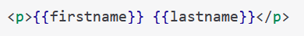

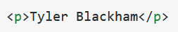
HTML TEMPLATING
The process of using templates embedded with placeholders to generate dynamic HTML content.

Slide 6



HTML TEMPLATING BENEFITS
SO WHAT?
DYNAMIC
MODULAR
REUSABLE
Allows you to inject data into your HTML
Helps your separate your application logic from you presentation logic
Allows you to create reusable templates

Slide 7

HTML TEMPLATING ENGINES
Mustache: “A logic-less templating engine that emphasizes simplicity and readability.”^{[1]}
EJS: “A simple templating engine that allows embedding JavaScript code directly in the templates.” ^{[1]}
Pug: “A concise and expressive templating engine that uses indentation to define the HTML structure.” ^{[1]}
Handlebars: “An extension of Mustache with additional features like helpers and block expressions.” ^{[1]}

Slide 8
HANDLEBARS
“MINIMAL TEMPLATING ON STEROIDS”^{[2]}

Slide 9




HANDLEBARS
CLAIMS TO FAME
MINIMAL
TEMPLATING
SEMANTIC
TEMPLATES
MUSTACHE-
COMPATIBLE
FAST
EXECUTION

Slide 10

CLAIMS TO FAME
Minimal Templating
Handlebars is lightweight and has zero external dependencies,
Easy to drop into any project.
Handlebars is logic-less.
The templates themselves do not have any logic to manipulate the data
Handlebars has a simple syntax.
Use the double curly braces {{ }}

Slide 11
CLAIMS TO FAME
Semantic Templates
Compiles down to semantic HTML (no custom elements or tags)
Handlebars templates are very human-readable
{{#if loggedIn}} <p>Welcome back, {{name}}!</p>{{/if}}
Handlebars allows for the creation of custom, reusable templates
“One of its most powerful features is the ability to extend the templating language’s functionality with custom helpers… The use of custom helpers in Handlebars promotes DRY (Don’t Repeat Yourself) principles “ by allowing developers to avoid repetitive coding patterns…” ^{[3]}

Slide 12
CLAIMS TO FAME
Mustache-Compatible
Extension of Mustache
Easy to swap out Mustache with Handlebars
Fast Execution
“Handlebars compiles templates into JavaScript functions. This makes the template execution faster than most other template engines.” ^{[2]}
“Handlebars templates compile into highly optimized functions that can quickly generate HTML” ^{[3]}

Slide 13
HOWEVER…
“Handlebars is not good for fast (incremental) updates of the DOM, event-handling, frontend-backend communication.” ^{[2]}

Slide 14
HANDLEBARS
LANGUAGE INTRODUCTION

Slide 15
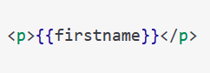
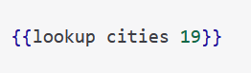
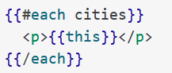
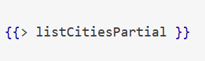
EXPRESSION TYPES
SIMPLE EXRESSIONS
BASIC HELPERS
BLOCK HELPERS
PARTIALS

Slide 16
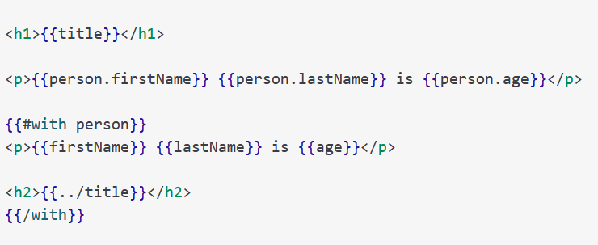
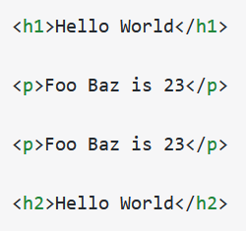
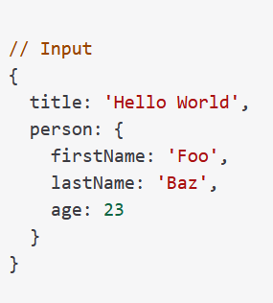
SIMPLE EXPRESSIONS
template
output
input

Slide 17
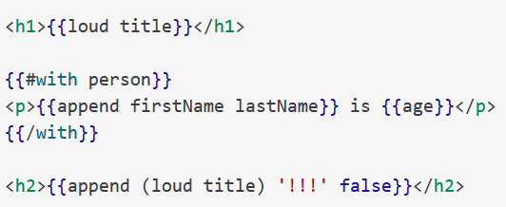
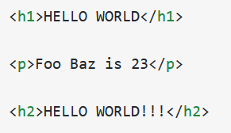
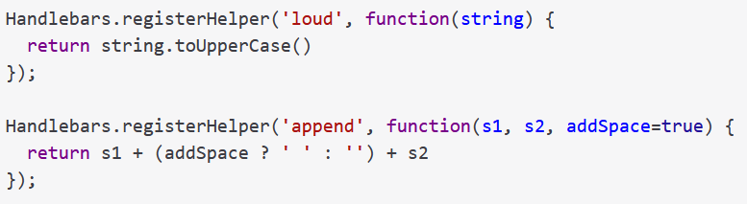
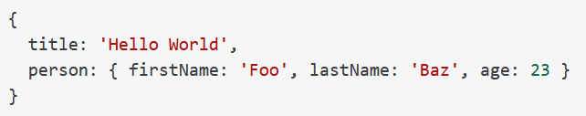
BASIC HELPERS
template
output
helpers
input

Slide 18
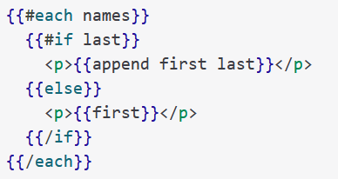
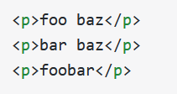
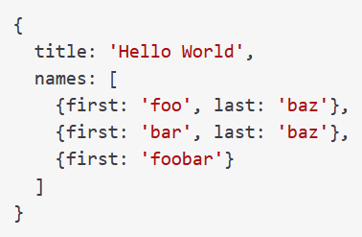
BLOCK HELPERS
template
output
input

Slide 19
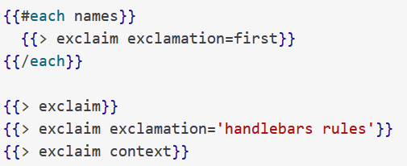
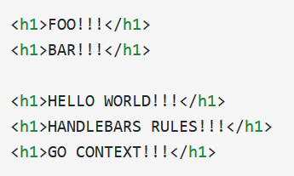
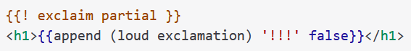
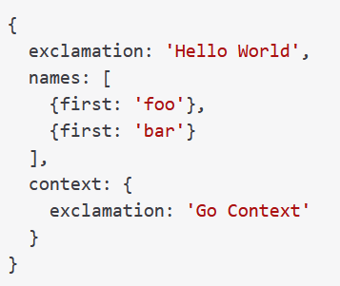
PARTIALS
template
output
partial
input

Slide 20
HANDLEBARS
DEMO
https://github.com/tylerablackham/handlebars-demo

Slide 21

QUESTIONS AND ANSWERS

Slide 22
BIBLIOGRAPHY

Slide 23
BIBILIOGRAPHY
[1] E. Robinson, “Top Templating Engines for JavaScript,” Caisy.io, May 29, 2024. https://caisy.io/blog/top-javascript-templating-engines (accessed Jul. 17, 2025).
[2] “Handlebars.js: Minimal Templating on Steroids,” Handlebarsjs.com, 2019. https://handlebarsjs.com/ (accessed Jul. 17, 2025).
[3] M. Vani, “React vs. Handlebars: Choosing the Right Tool for Progressively Decoupled Applications,” Medium, Mar. 23, 2024. https://medium.com/@marcelovani/react-vs-handlebars-choosing-the-right-tool-for-progressively-decoupled-applications-1d421ea4e0fc (accessed Sep. 26, 2025).

